Slide 1
MOBILE APPLICATION DEVELOPMENT Food Ordering App: Foody Key
FINAL PROJECT

Slide 2

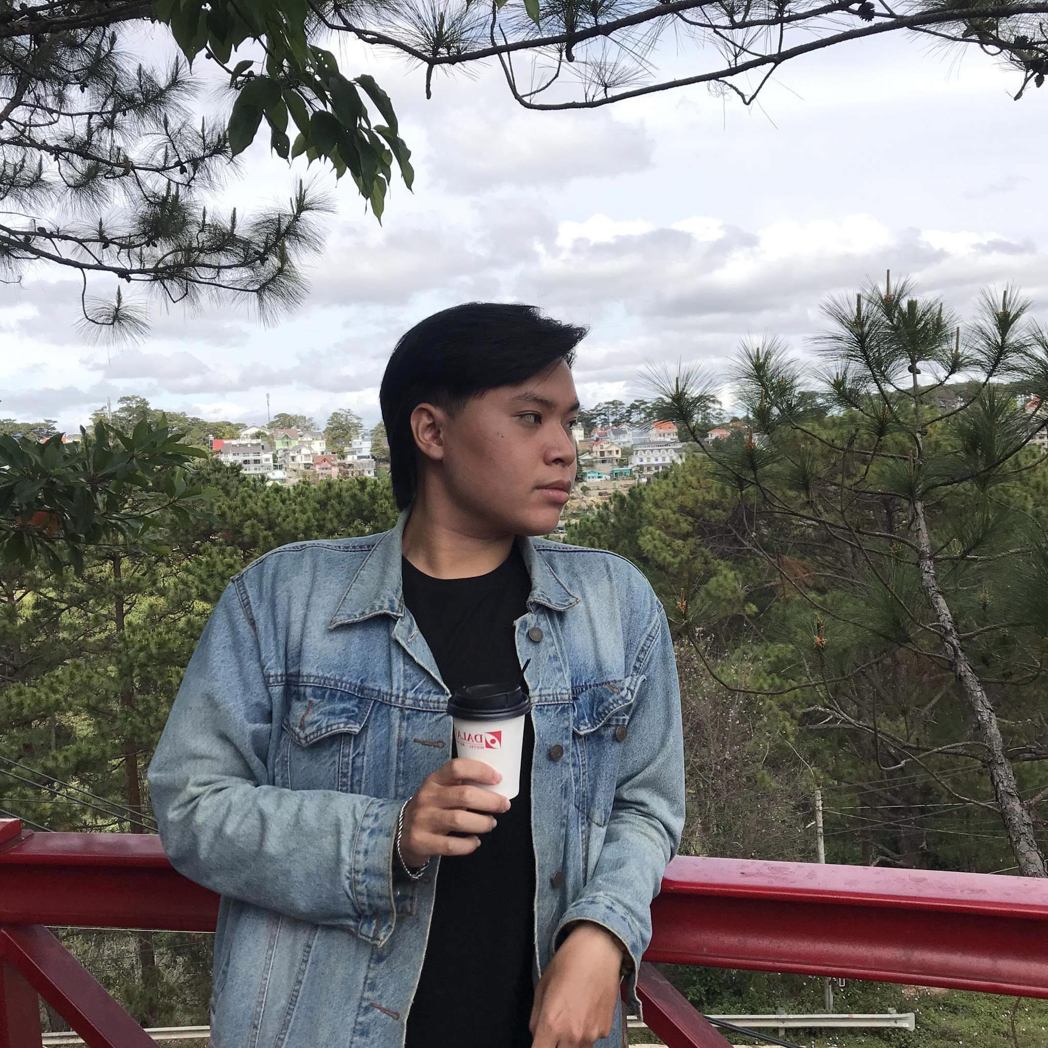


GROUP MEMBER
From UIT
Dang Hai Trang Phuc
19522026@gm.uit.edu.vn
Vo Nguyen Dang Khoa
19521704@gm.uit.edu.vn
Lecturers: Nguyen Thanh Binh – Tran Vinh Khiem

Slide 3
Table of Contents
INTRODUCTION
Introduction to the reasons for conducting the Project and a brief overview of it.
APPLICATION
Show app operation methods, deployment applications, and implementation Software.
REFERENCES & DEMO
Cite references, video tutorials. Start the app and present all the functions and operations of the Foody Key Application.
Conclusion
Expressing heartfelt gratitude to the Teachers, then setting goals to improve and develop Application.

Slide 4
1.
INTRODUCTION
Overview of the project

Slide 5
In Italy or anywhere, one cannot think well, love well, sleep well, if one has not dined well.
- Truong Anh Ngoc -

Slide 6
Reasons for choosing the application
Utilities for Users.
Market Potentials.
Popularity of Food Ordering Apps.
Learn and Develop Skills through doing Project.

Slide 7
What can customers do on the application?

Slide 8
Permission to control and use
ADMIN
-Add/Edit/Update/Delete User accounts
-Send E-mail (if User Reset Password)
-Add/Edit/Update/Delete Products
-Check Feedback/Order
CUSTOMER
-Sign Up/Reset Password/Sign In
-View/Check detail products
-Add products to Cart/Order
-Enter/Send Feedback
-Contact the System Directly
-Check Order History

Slide 9
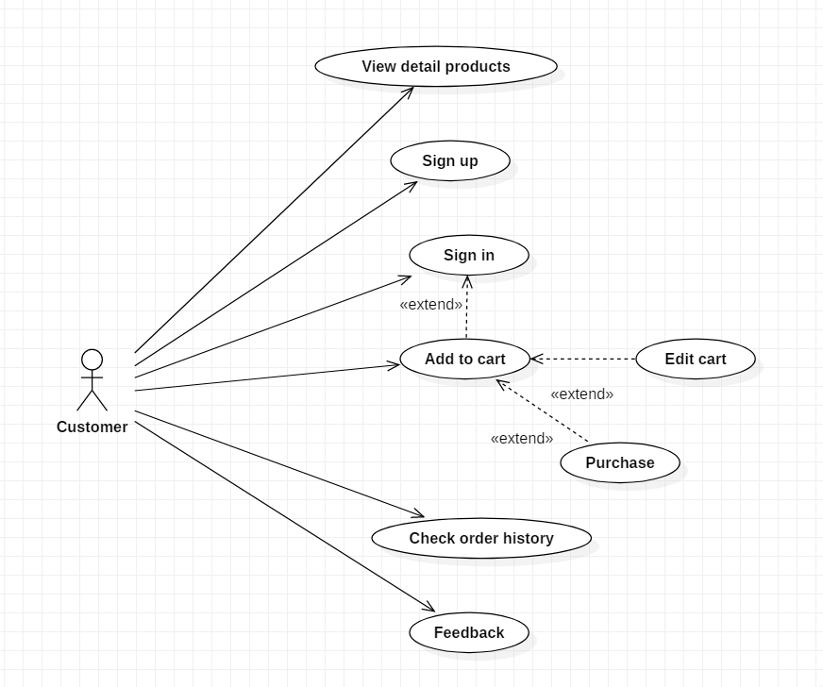
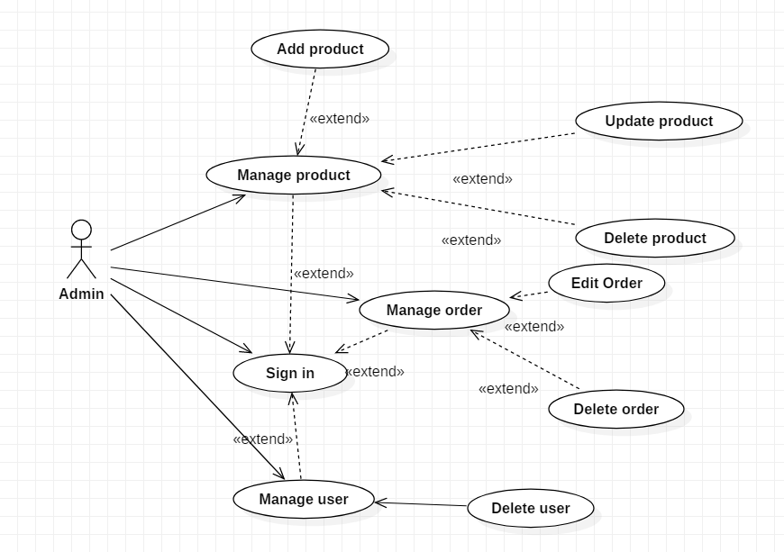
USE CASE DIAGRAM
USE CASE DIAGRAM

Slide 10
2.
APPLICATION
Describe how the app works

Slide 11
🍅
: user
🍅
🍅
🍅
Today, the number of users/customers is increasing over time.
🍅
🍅
🍅

Slide 12

Besides, the number of food/drinks is also more and more diverse and abundant.
Can you guess the food in picture?

Slide 13
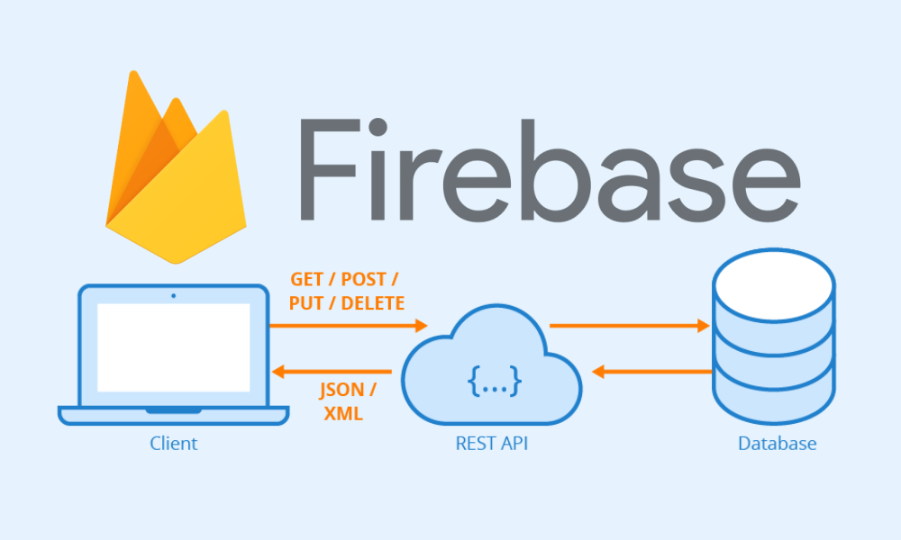

Slide 14
88,191,122GB
The data is stored in Firebase after Google acquired
the mobile and web app development platform.

Slide 15
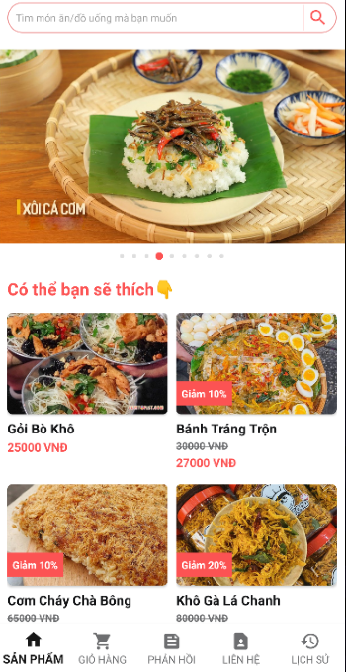

Layout and main interface of the app
Certainly, it is impossible not to mention the Android Stuido software that is the software that makes FoodyKey application.
It provides tools and resources for developers to build, test, and deploy Android applications.
ANDROID Studio

Slide 16
Application Deployment Process
Application
Firebase
Android Studio
Users Data Storage
Products Data Storage
Code Editor
Handle Function
Design Interface/Layout

Slide 17
3.
REFERENCES & DEMO
Cite references and start application

Slide 18
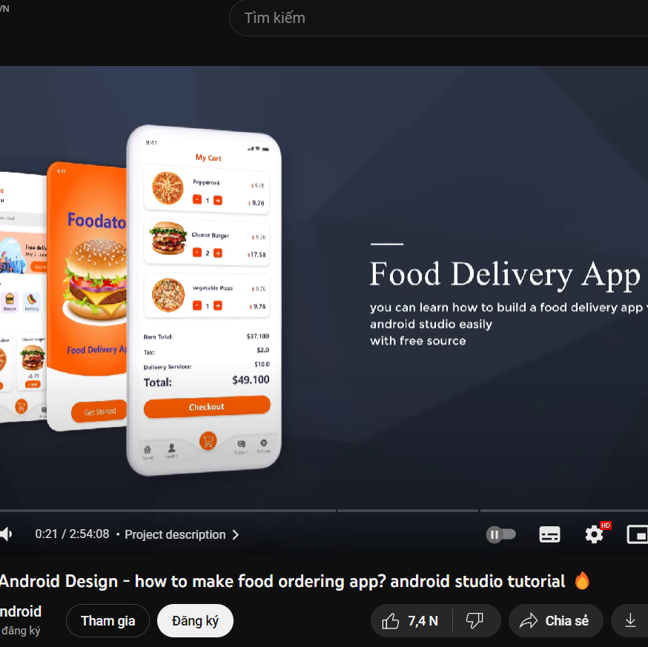
References
*References Website:
[1] https://stackoverflow.com/
[2] https://chat.openai.com/ (ChatGPT)
[3] https://www.youtube.com/watch?v=9nWcPPHBzMk
[4] https://firebase.google.com/docs/database/android/start
[5] https://github.com/Tarikul711/flutter-food-delivery-app-ui
[6] https://viblo.asia/p/tim-hieu-action-bar-compat-trong-android

Slide 19
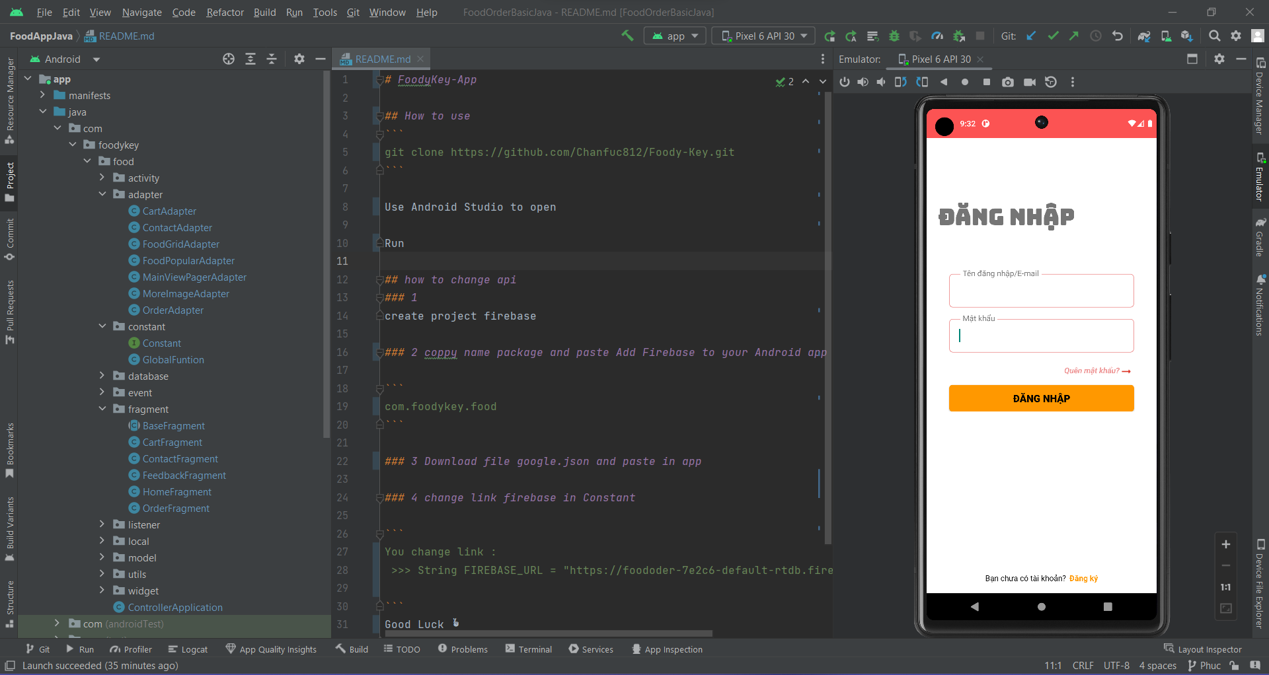
Demo
*Link Video Demo:
https://foodykeydemo.page.link/VideoDemoProject

Slide 20
4.
CONCLUSION
Outline scope and direction of app development

Slide 21
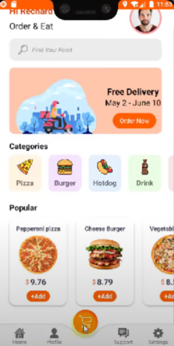
Future goals to improve and develop app
We will try to develop newer interfaces and functions (listed below), thereby improving and perfecting the application in the best way.
Adding a section to categorize different types of food.
Adding a product size selection option and allowing customers to specify their preferred level of sweetness, ice, or any additional requests.
Improving user interface: adding direct information to the application so that customers can update details and also including a logout section for customers to login with a different account.
develop application to achieve the best performance

Slide 22
Sincere ThankS
According to above project, we would like to sincerely thanks Mr. Nguyen Thanh Binh and Mr. Tran Vinh Khiem for teaching us, equipping us with valuable knowledge and creating good conditions for us to do well in this subject.
Because this is only a subject project, we also have limited knowledge and experience. Although we have tried to complete the project within the scope and capacity allowed, it is still inevitably that there will be shortcomings.
We look forward to receiving the sympathy and enthusiastic comments from Teachers!

Slide 23
Thank You For Your Attention!
Any questions?
You can find me at:
@chanfucc & nguoispecial@gmail.com

Slide 24
Credits
Special thanks to all the people who made and released these awesome resources for free:
Presentation template by SlidesCarnival
Photographs by Unsplash

